Slide 1





Barani Institute Of Information Technology

Slide 2
PROJECT TITTLE:
Digital Tasbeeh With Friends
SUPERVISED BY:
Muhammad Azeem
GROUP MEMBERS:
Abdullah Ayaz (2021-Arid-4391)
Amna Ejaz (2021-Arid-4408)
Ch Huzaifa Ali (2021-Arid-4422)
Abdul Qadoos (2021-Arid-4385)
Ramish Wazir (2021-Arid-4575)

Slide 3
INTRODUCTION
Digital Tasbeeh with Friends is a mobile app that enhances spiritual practices by enabling individuals and groups to set, share, and track tasbeeh goals . With features like compound tasbeeh creation, and automated notifications, it fosters collaboration and convenience in achieving shared objectives.

Slide 4
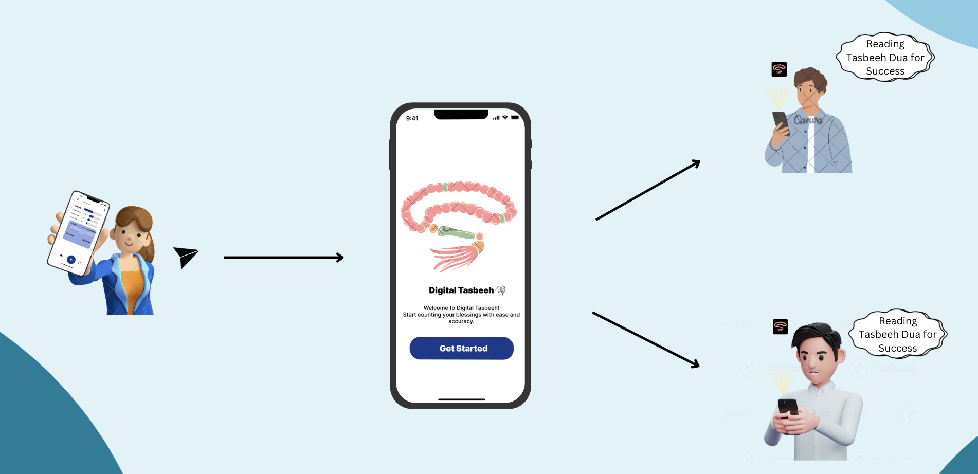
CONCEPTUAL DIAGRAM

Slide 5
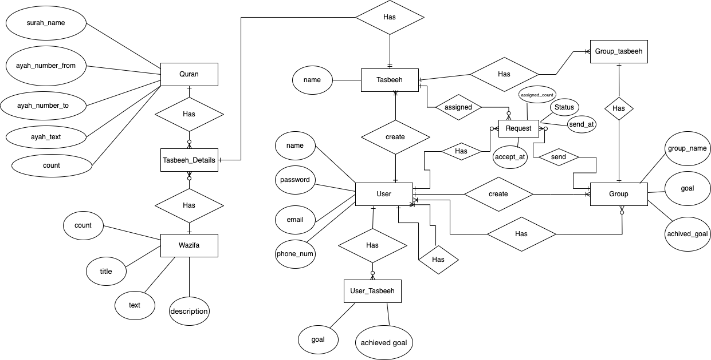
ENTITY RELATIONSHIP DIAGRAM

Slide 6

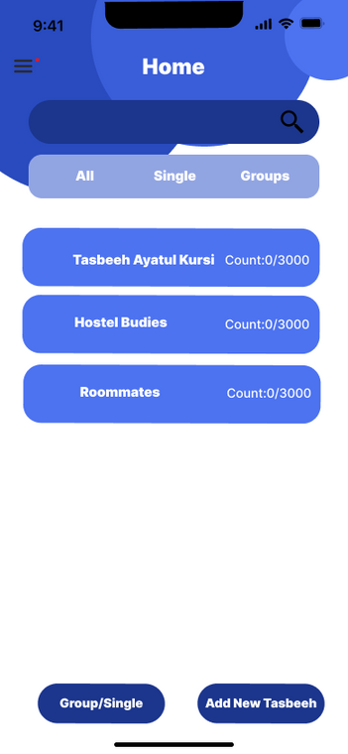
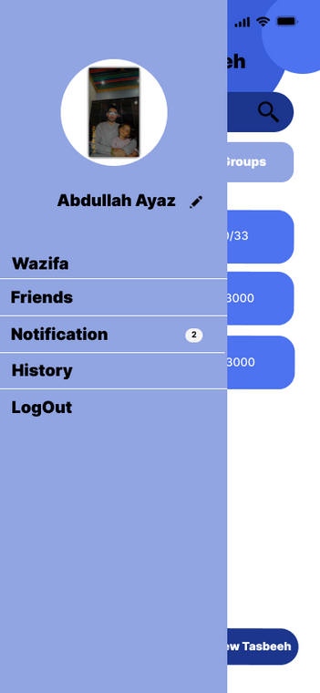
HOME

Slide 7
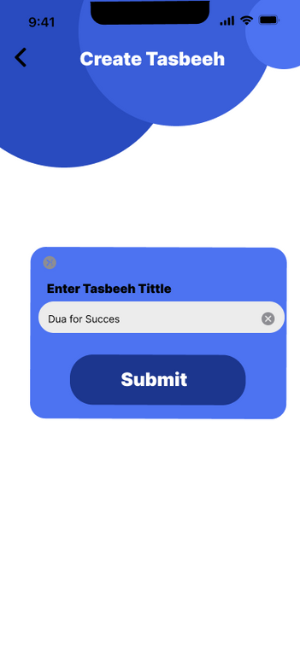
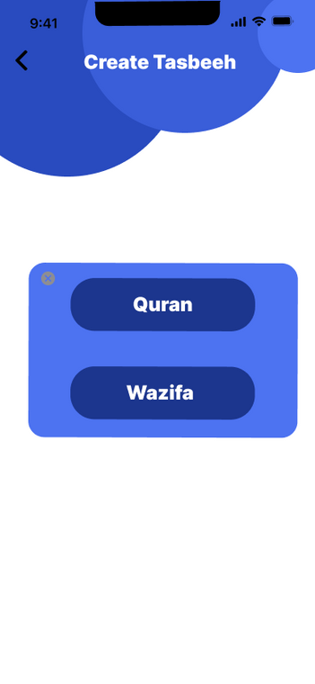
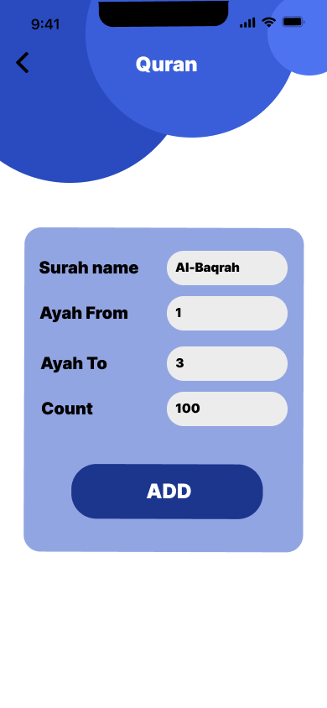
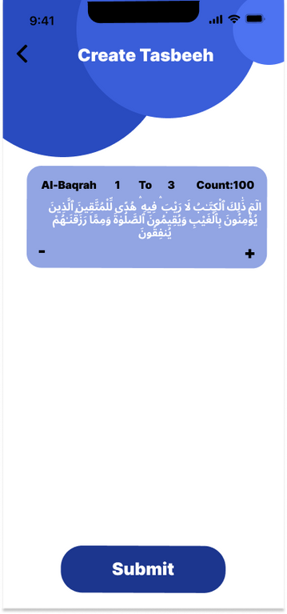
CREATE TASBEEH

Slide 8
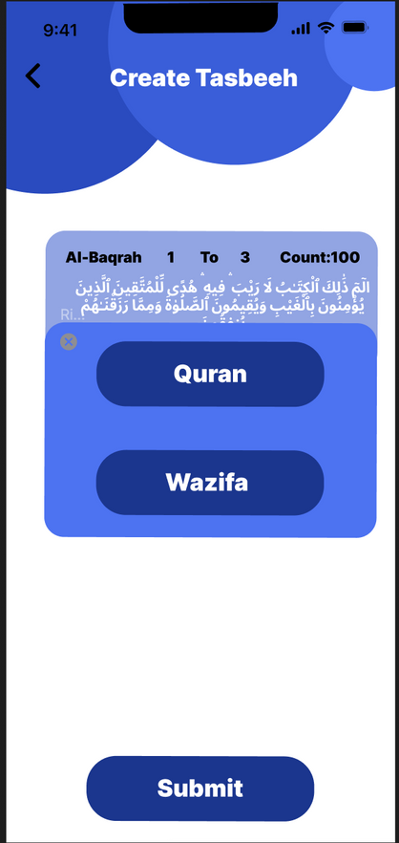
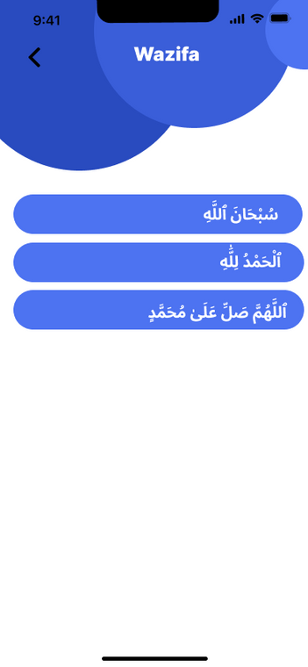
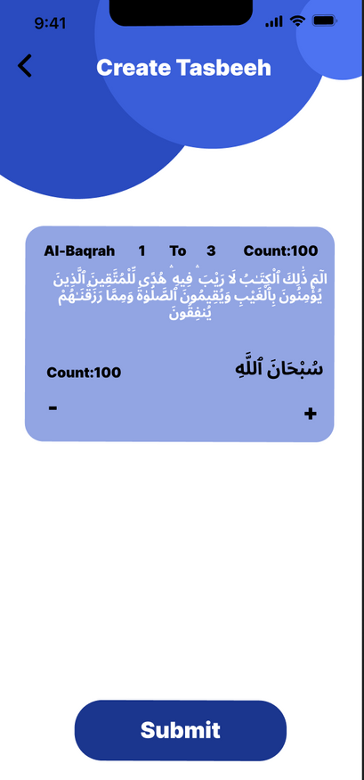
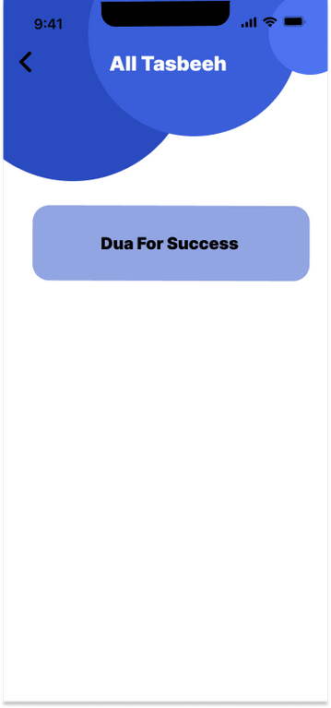
CREATE TASBEEH

Slide 9
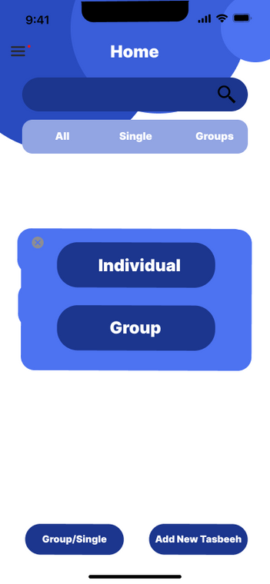
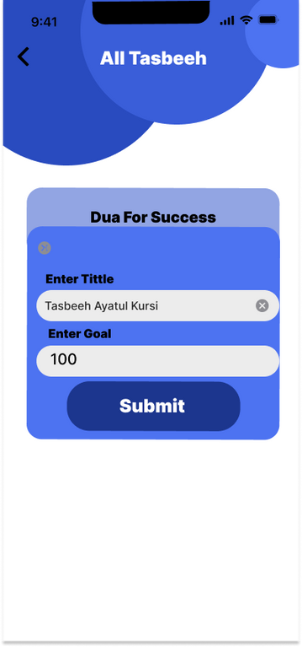
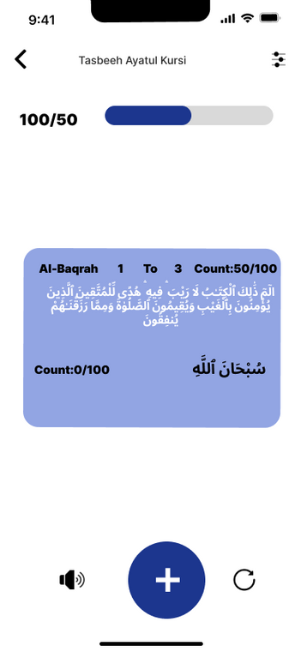
CREATE SINGLE TASBEEH

Slide 10
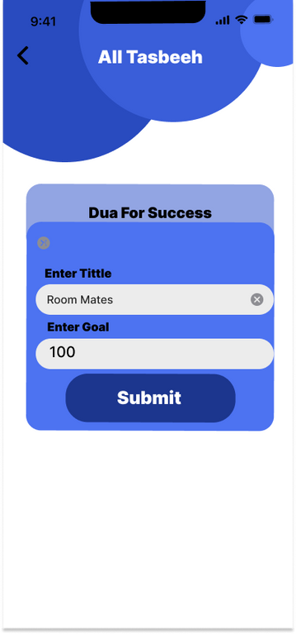
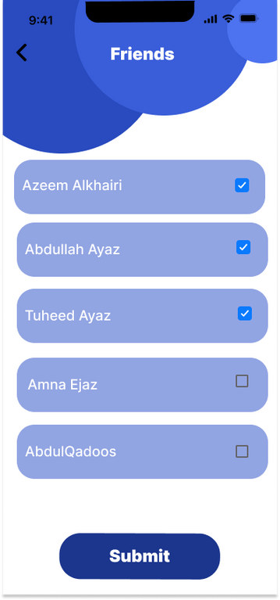
CREATE GROUP TASBEEH

Slide 11
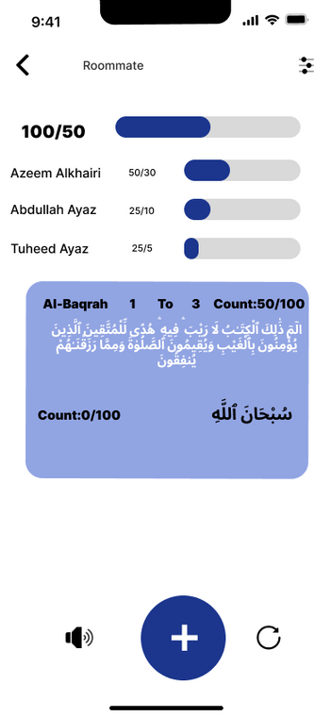
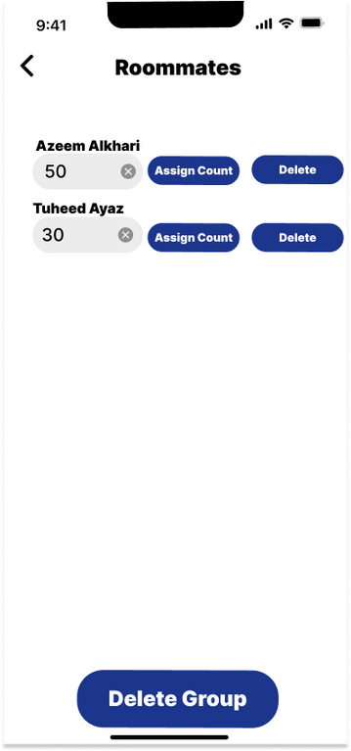
ASSIGNED COUNT TO MEMBER

Slide 12
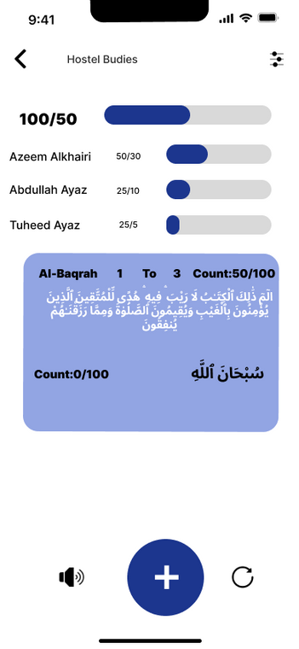
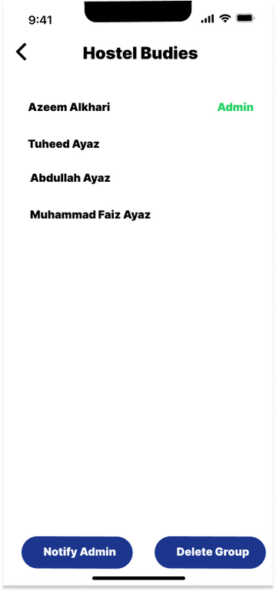
USER AS MEMBER IN GROUP

Slide 13
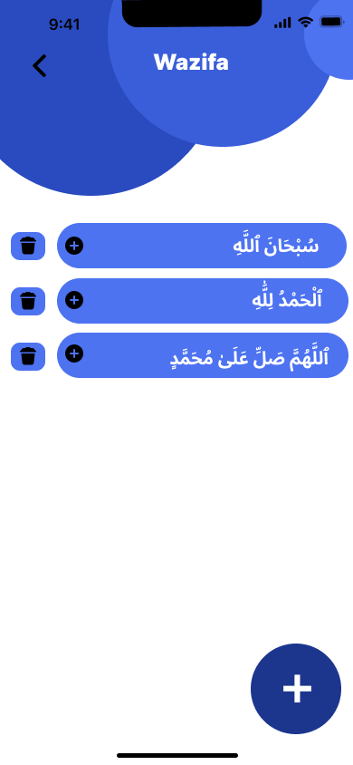
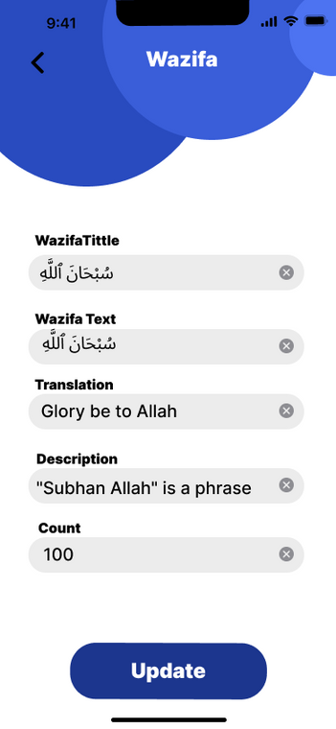

ADD WAZIFA

Slide 14
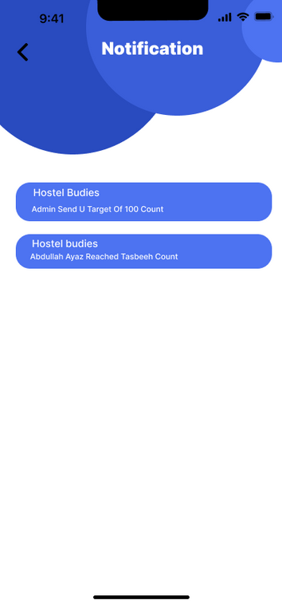
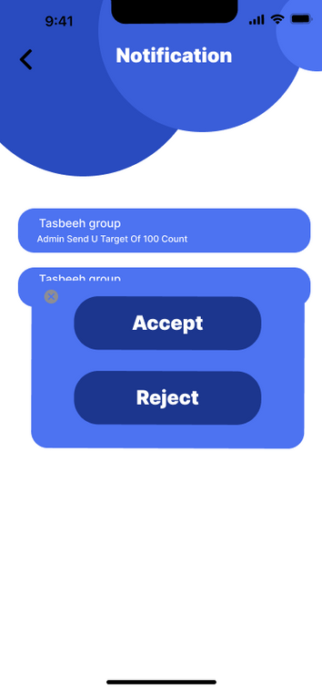
NOTIFICATION

Slide 15
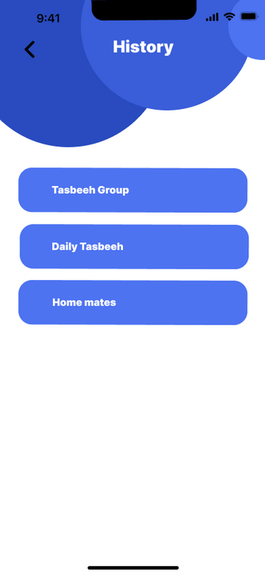
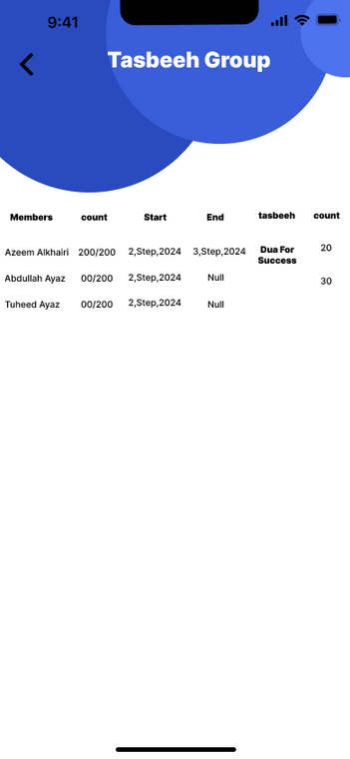
HISTORY

Slide 16
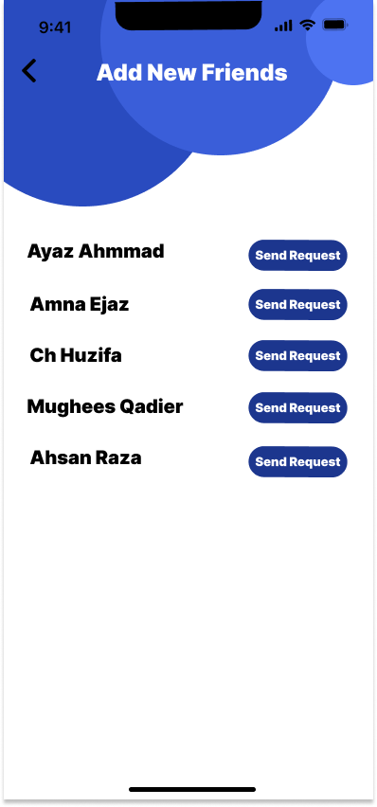
Friends

Slide 17
THANK
YOU

